Slide 1
RouteLink – Smart Ride Sharing Platform
Drive smarter — match, share, and save on every journey.
By Dinesh Sura

Slide 2
Introduction
RouteLink is a modern ride-sharing platform.
It connects drivers and riders traveling on similar routes.
The platform focuses on real-time ride sharing, transparency, and trust.

Slide 3
Problem Statement
• Costly intercity and intracity travel
Most vehicles have empty seats.
Travel costs are high.
• Lack of route-based ride-sharing systems
• No real-time trustable booking and tracking mechanism

Slide 4
Proposed Solution
• A complete web-based system for smart carpooling
• RouteLink connects drivers and riders using smart routing.
Riders can book along driver’s planned path.
• Secure JWT authentication, ratings, and real-time updates
Focus on cost sharing + trust + convenience.
Smart Search – “Along route” & “Nearby route” matching.

Slide 5
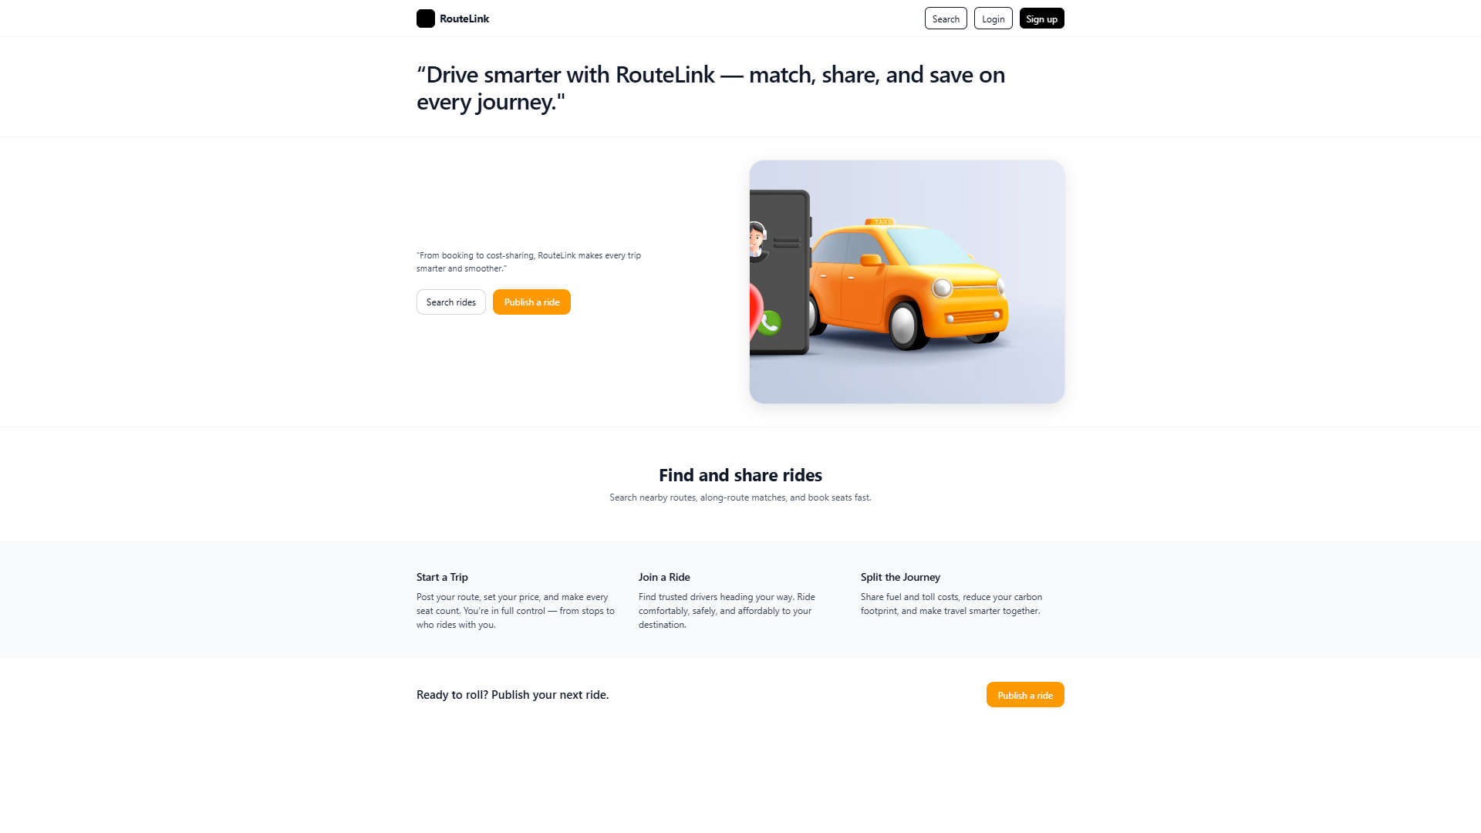
Landing Page (Frontend Preview)
Clean and modern UI – users can publish or search rides instantly.

Slide 6
System Architecture
• Frontend: React + Tailwind CSS
• Backend: Spring Boot + REST APIs + JWT Authentication
• Database: PostgreSQL (pgAdmin)
• Tools: Postman, VS Code, Maven
The system follows a modular microservice-like architecture.

Slide 7
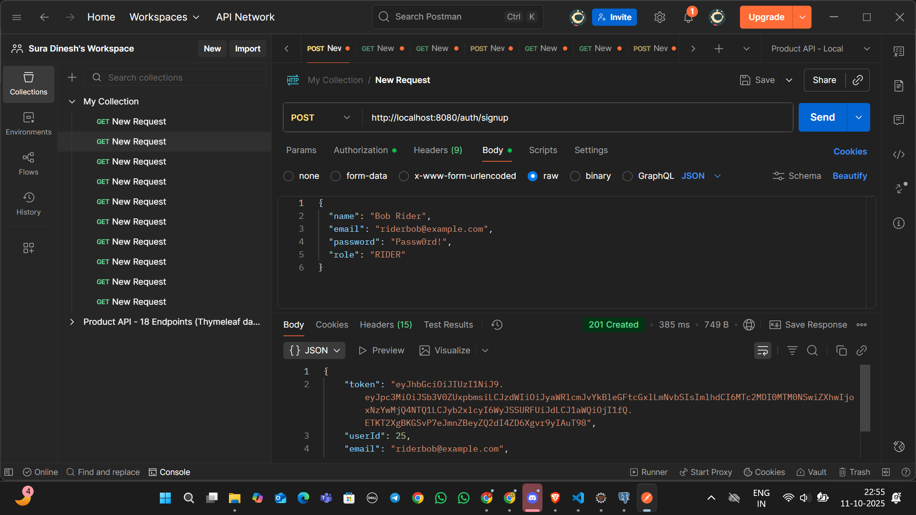
Backend API Testing (Postman)
Testing REST APIs such as signup, trip posting, and booking confirmation.

Slide 8
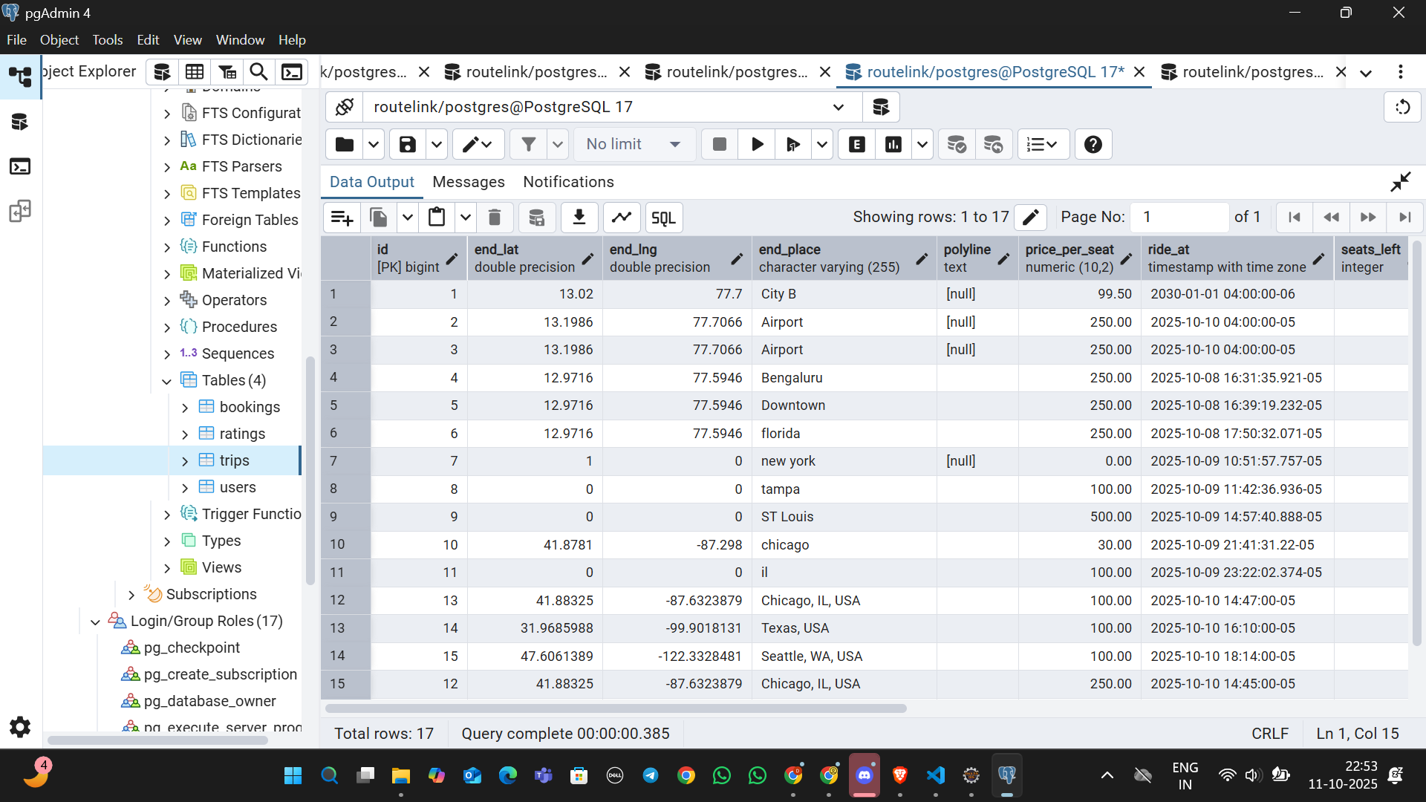
Database (PgAdmin View)
Database tables: users, trips, bookings, and ratings with live entries.

Slide 9
Core Features
• Role-based login for Drivers and Riders
• Trip creation, booking, and confirmation workflows
• Along-route matching algorithm for route-aware rides used google maps
Places API for real time location suggestions
• Ratings and trip closure system
Email notifications sent automatically on trip confirm, decline and cancel
actions to ensure instant communication.

Slide 10
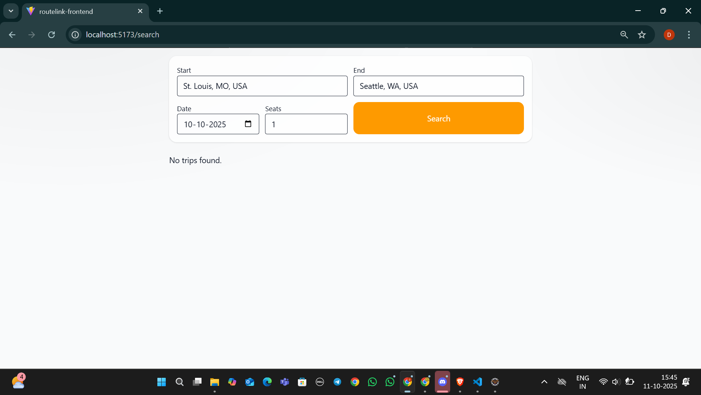
Search and Trip Matching
Rider searches trips by location and seats availability.

Slide 11
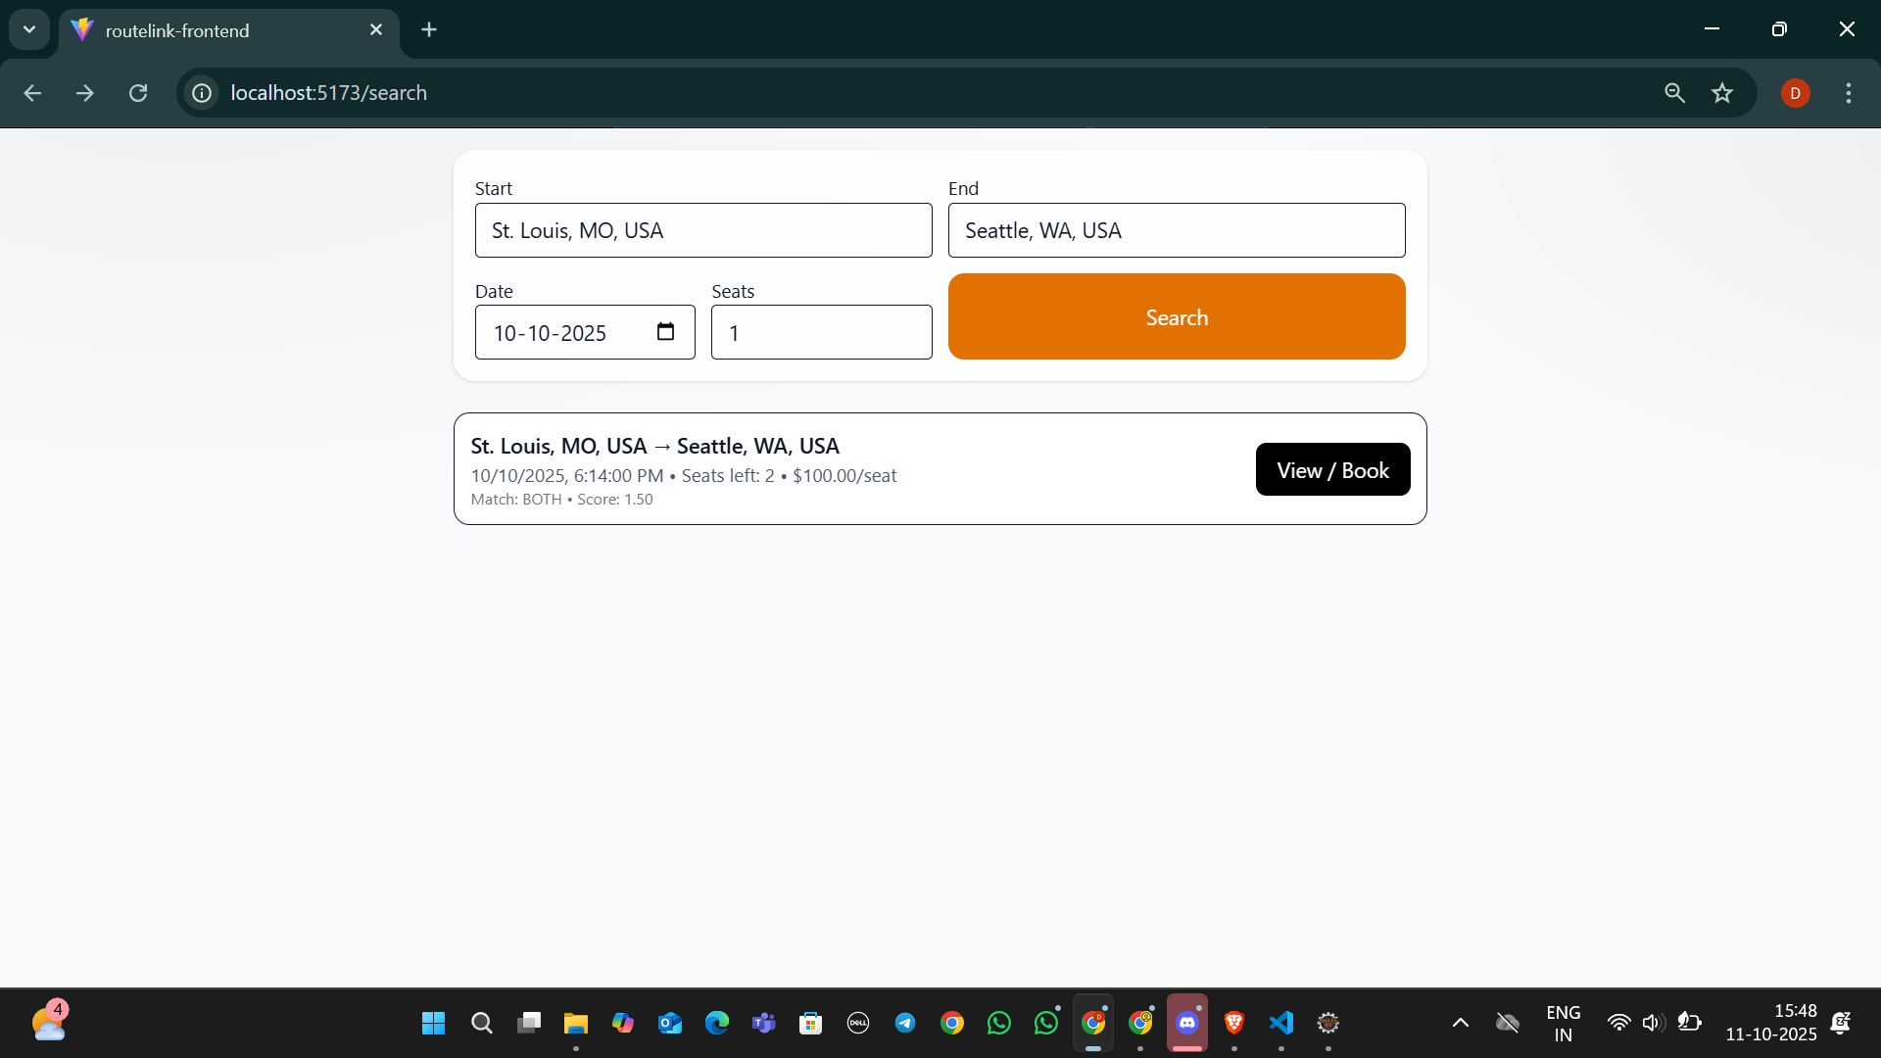
Search Results & Booking
Matching trips are displayed with route and price details.

Slide 12
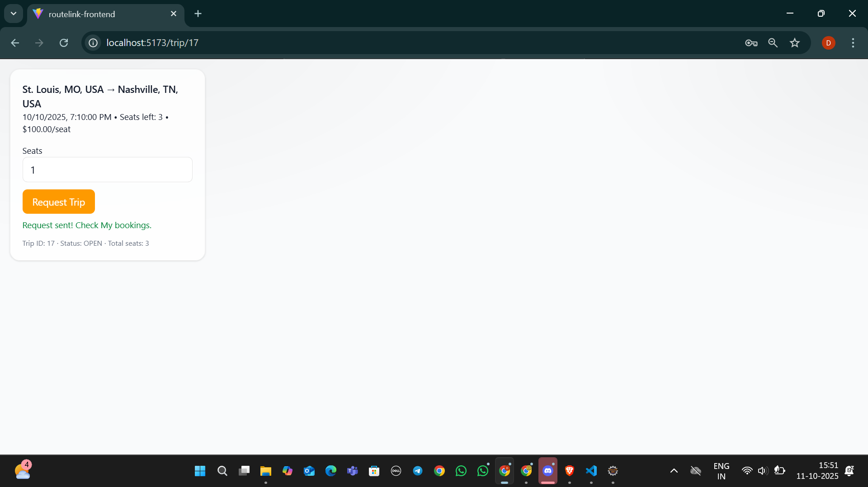
Booking Confirmation
Rider requests seats; confirmation handled via driver dashboard.

Slide 13
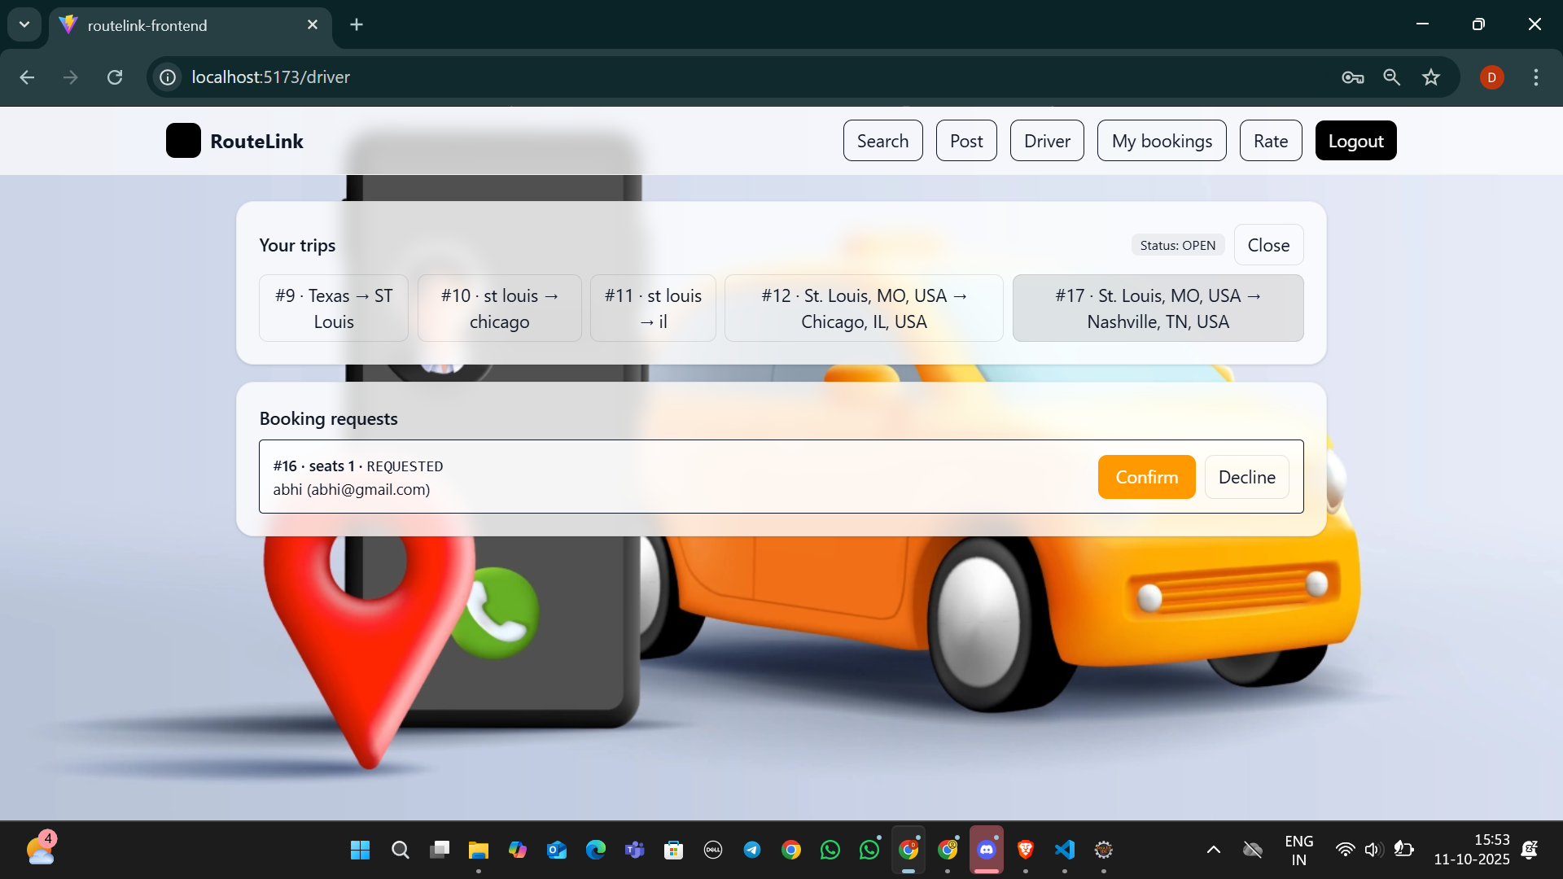
Driver Dashboard
Drivers can view booking requests and confirm or decline them.

Slide 14
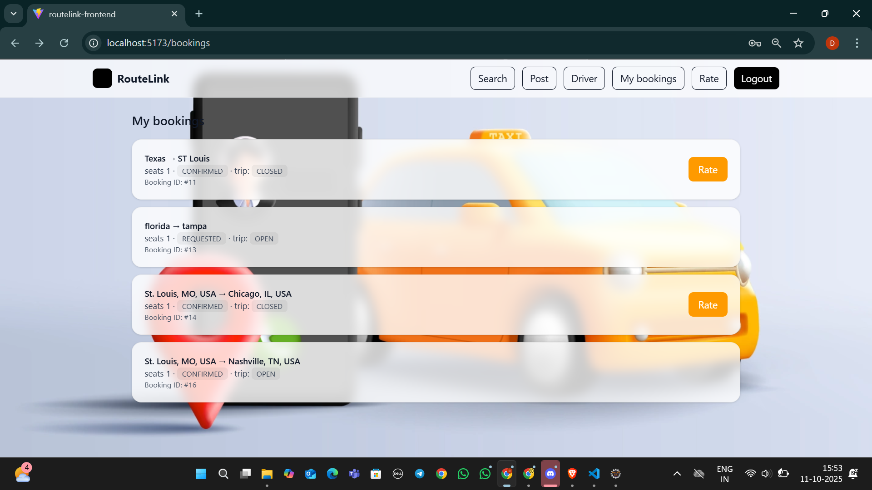
My Bookings & Ratings
Riders can view completed trips and submit feedback.

Slide 15
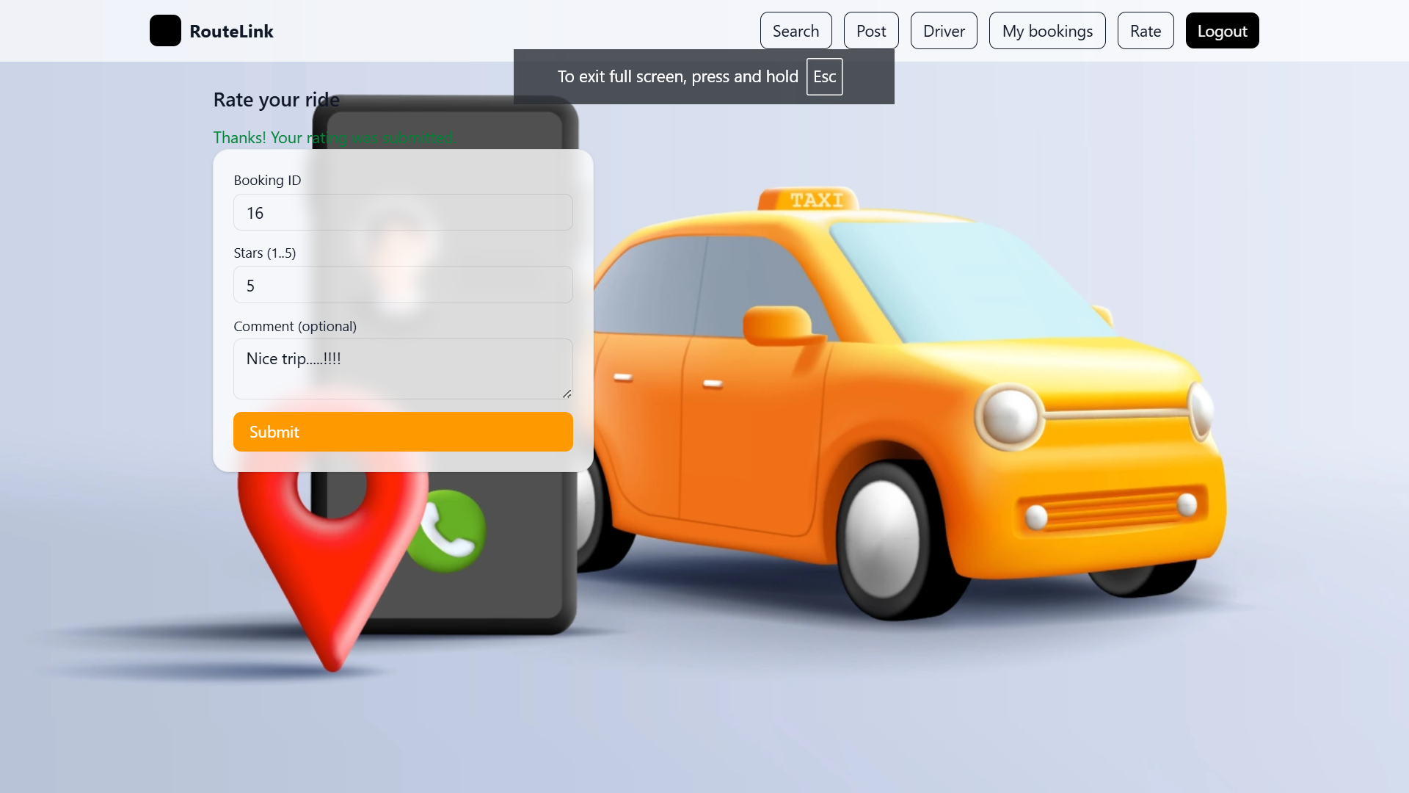
Rating Submission
Rating form allows 1–5 stars with optional comments.

Slide 16
Technical Highlights
• Spring Boot backend with layered architecture
(Controller → Service → Repository)
• Secure authentication using JWT tokens
• REST API communication between backend and frontend
• React components for modular and reusable UI design

Slide 17
Results & Achievements
• Successfully integrated backend and frontend with live database.
Secure login + JWT verified roles.
• Completed functional flow:
signup → post trip → booking → confirmation → rating.
• Responsive and user-friendly UI tested on multiple devices.
Drivers save money, riders save time.

Slide 18
Conclusion & Future Scope
✅ Fully functional end-to-end RouteLink system built using Spring Boot
and React.
✅ Implements real-time trip management and user rating system.
🚀 Future Enhancements:“Implement a rider pairing feature where multiple
riders booking the same trip are automatically grouped together, allowing
them to view and coordinate with their co-riders
"Real-time chat between driver and rider"
“Enable drivers to publish their full route with ordered ‘along-the-way’ stops,
showing direction of travel and stop-wise(with kilometers) seat pricing“.

